Slide 1

Java ATM project
Team 2 - camshajuan

Slide 2
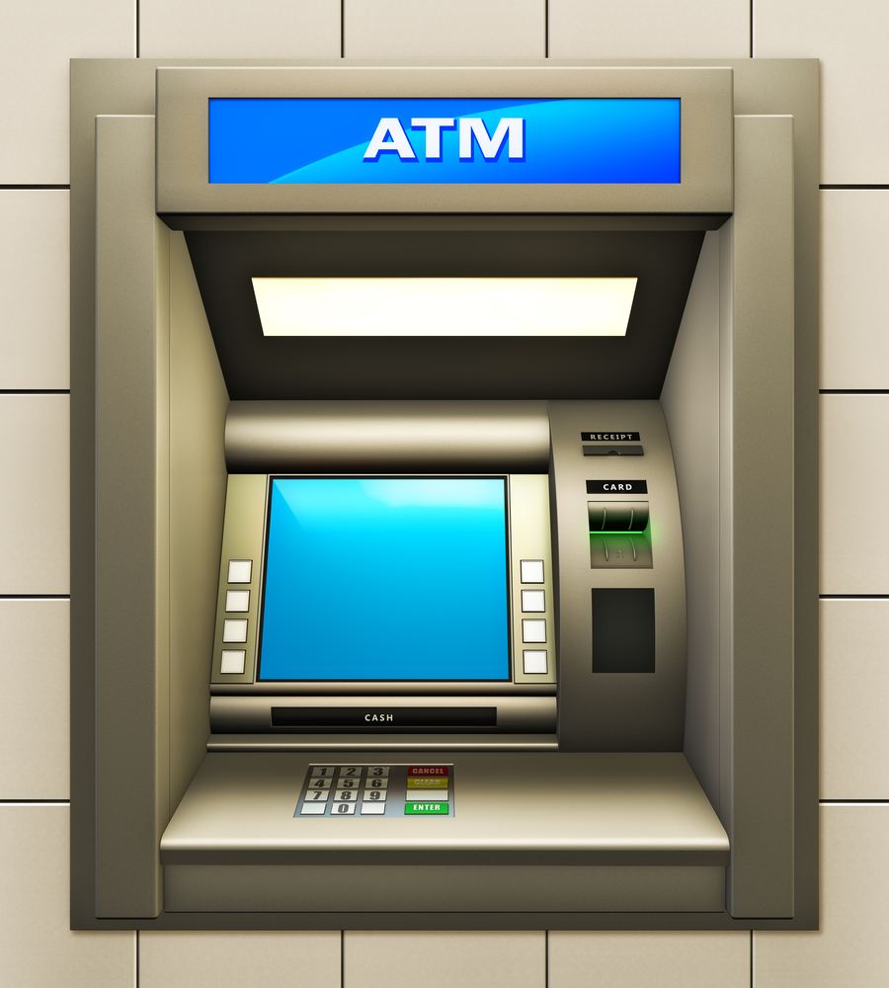
Presentation agenda
Team & Project Introduction
Our Process & Experiences
Project Demonstration
Q&A

Slide 3

Team & Project introduction
UML Diagrams
User Stories
Introductions
Team Coordination

Slide 4
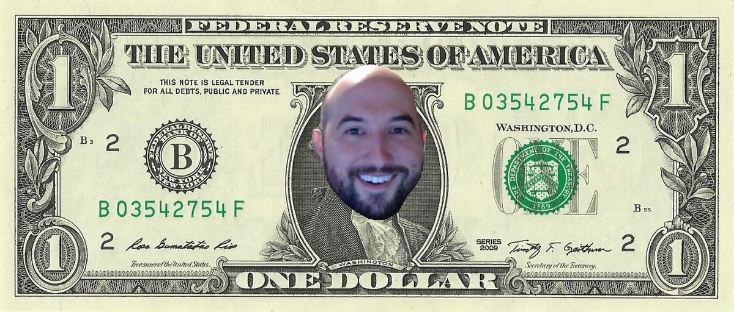
Shawn Blair
Prior USAF Networking/Signals Technician
Loves food/music/learning
Minimal OOP Software Experience prior to course
Excited to continue learning more System Design/Full-Stack Languages/Implementation

Slide 5
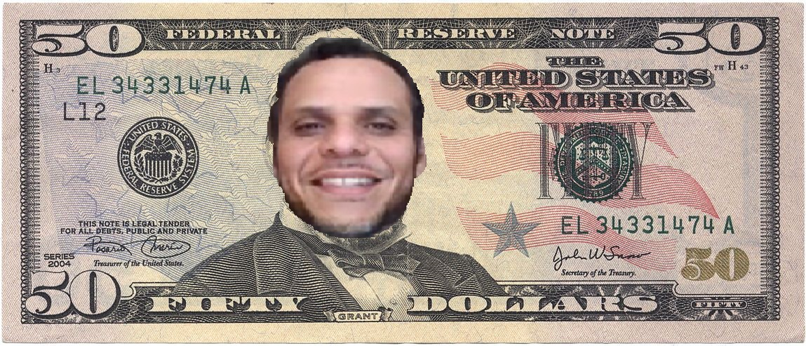
Juan Cruz
Retired Special Forces Communications Sergeant
Loves going beach with Family /Seafood/running/crossfit
Prior coding experience – Software Development Certificate
continue learning new technologies and sharpening my coding skills

Slide 6
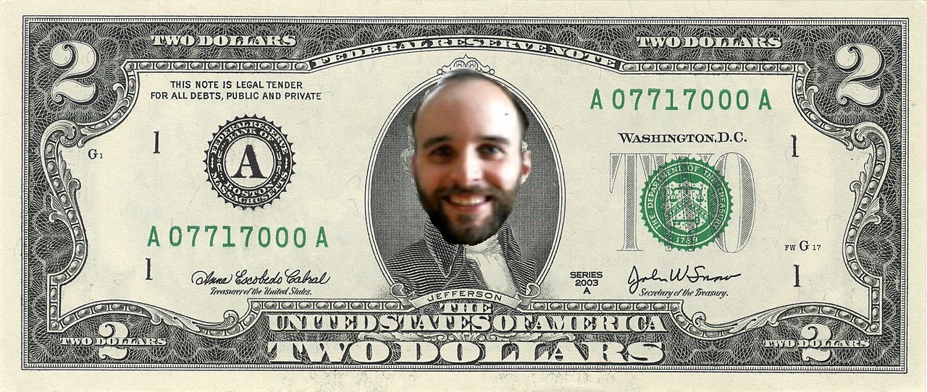
Cameron Davis
Pre-apprentice
Mechanical Engineering background
Prior USAF Developmental Engineer
Loves traveling/gaming/my cat
Previous coding experience: MATLAB
Desired course outcomes:
Entry into new career field
Gain understanding of specializations and narrow down on interests

Slide 7
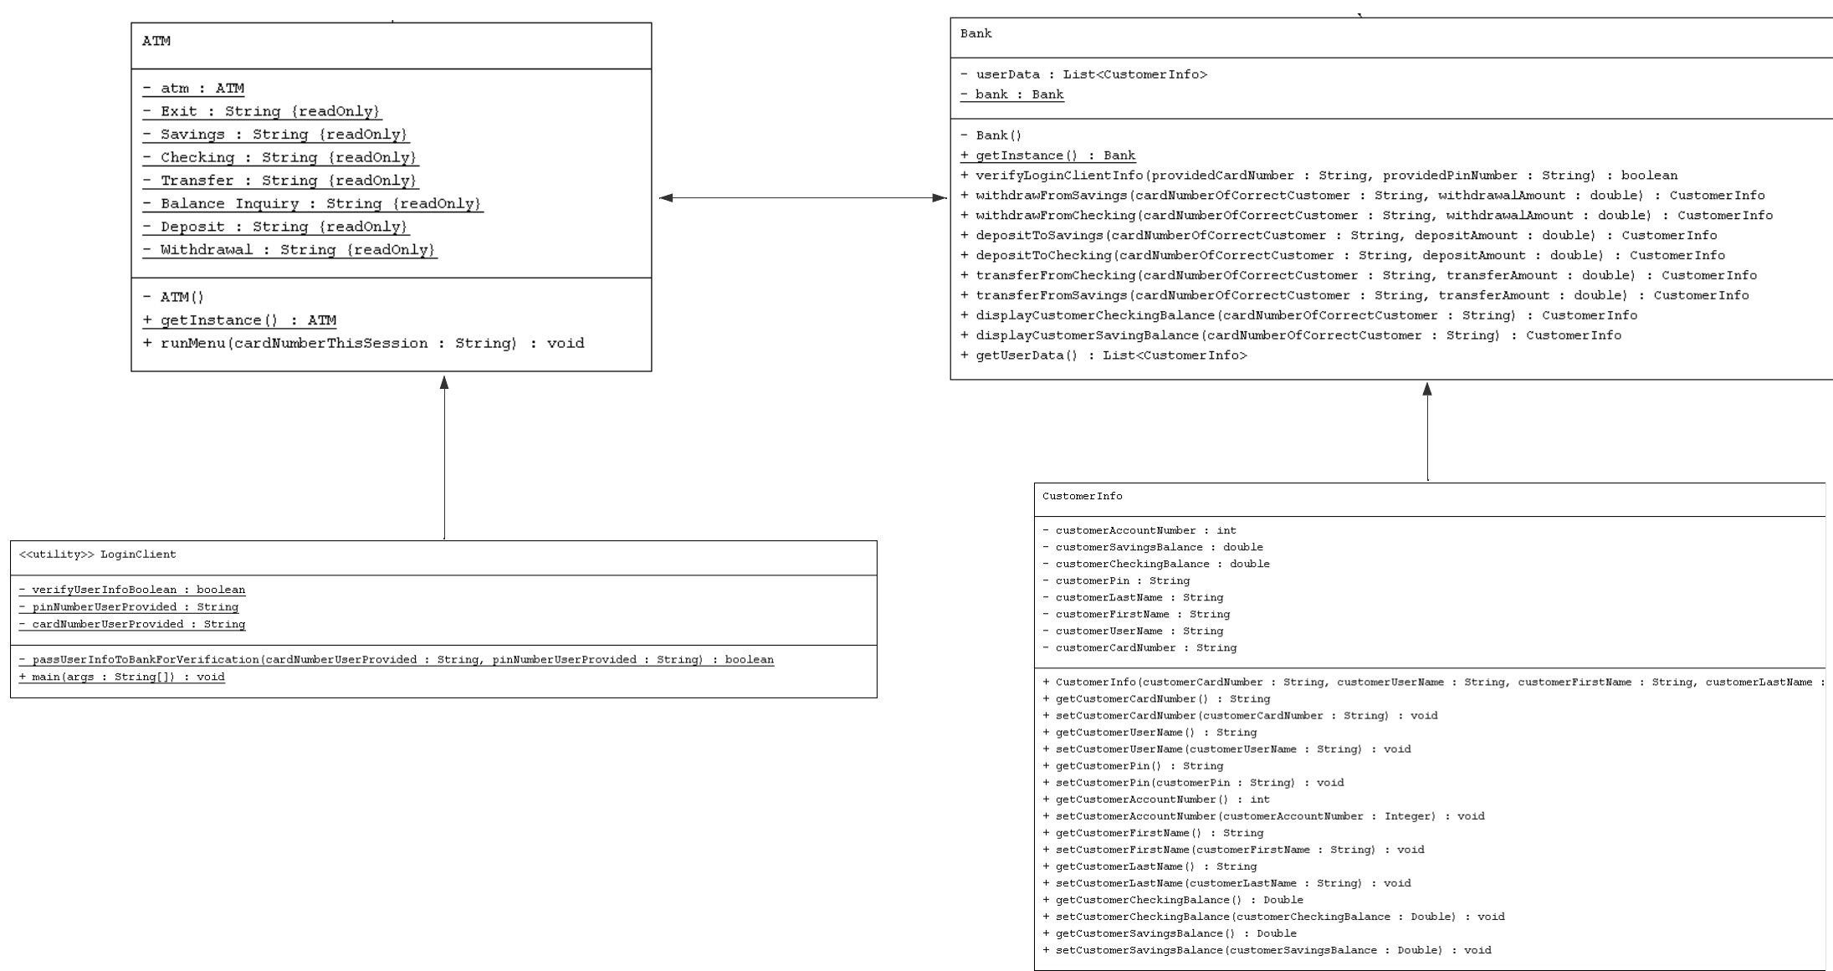
UML DIAGRAM (UML GEN & LUCIDCHART)

Slide 8
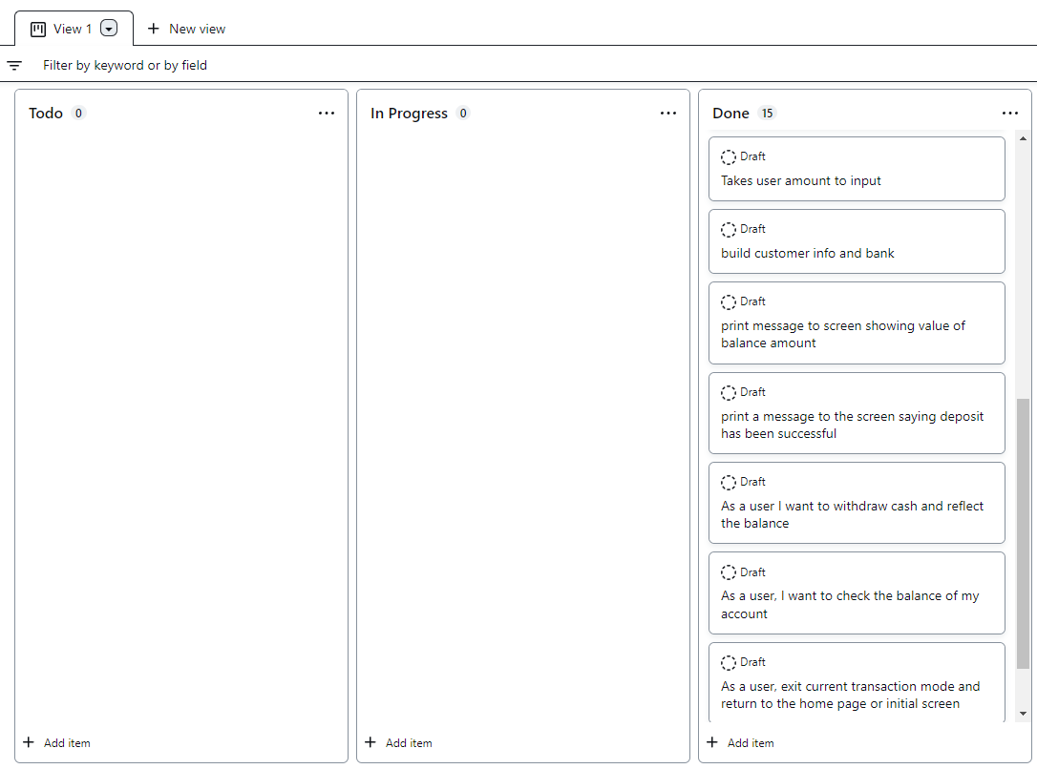
OUr Project's Stories
Wrote Stories from Customer POV to better understand implementation
Utilized GitHub Project Board for tracking

Slide 9
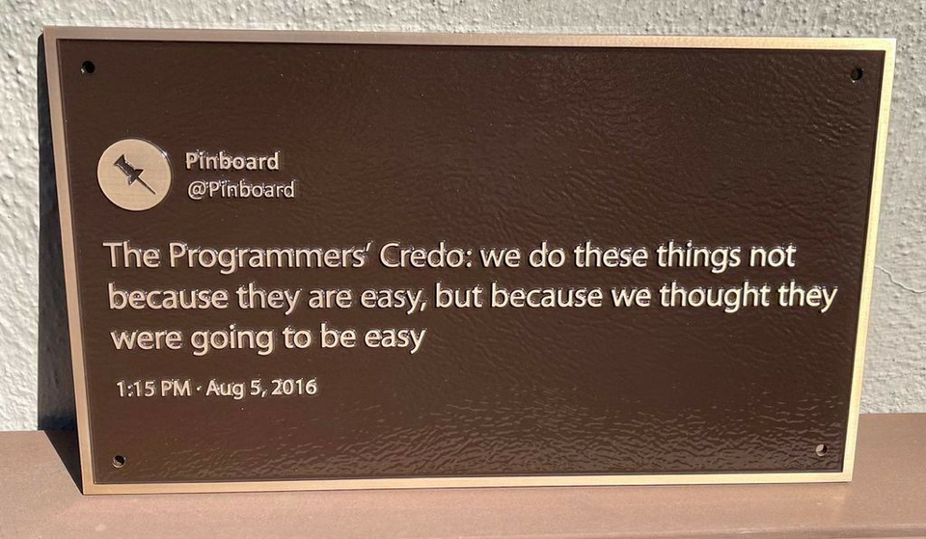
Team Coordination
We focused on major issues together, which fast-tracked resolving those problems
Able to split and breakout to utilize those concepts in other areas
Learning each other's skillset and utilizing to our advantage
Protecting customer data was essential, we utilized Singleton (InstanceOf), protected classes, and other methods to help secure it
Creating a Minimal Viable Product (MVP) was tougher than initially expected

Slide 10
Our processes & Experiences
Test Code
Mistakes Made/Lessons Learned
Design Patterns & Practices
Features We'd Add Given More Time

Slide 11
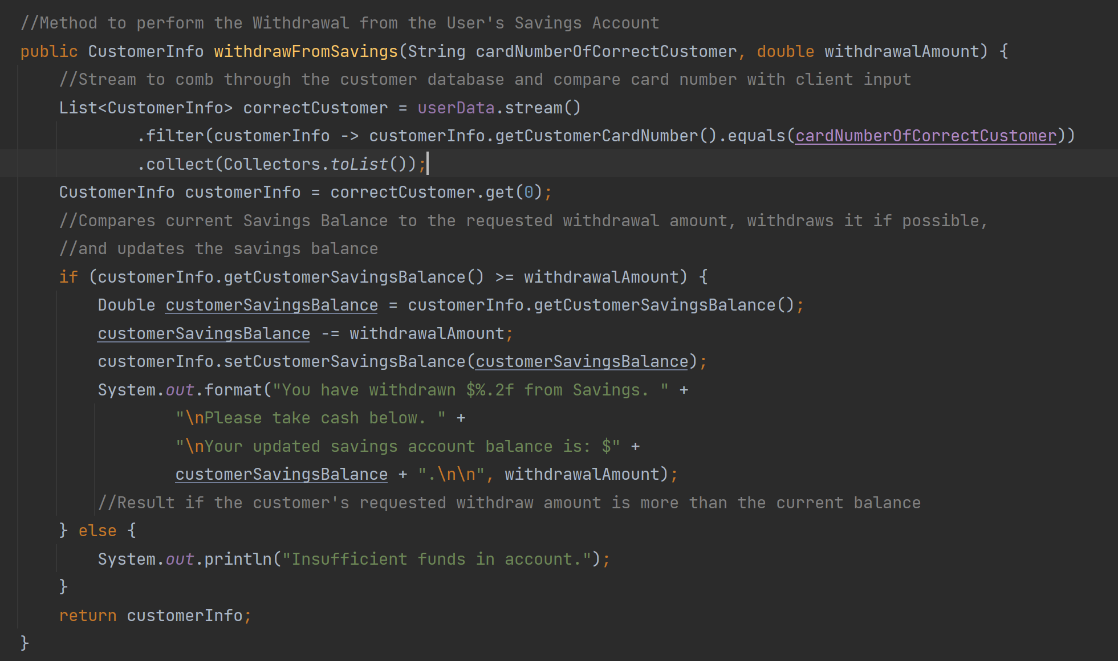
Design Patterns & practices
Single Responsibility Principle – code coupling (variable UI implementations), project considerations (any ATM functionalities we didn't capture)
Don't Repeat Yourself Principle – how did we do?
Design/Strategy Patterns – what did we use, why?

Slide 12
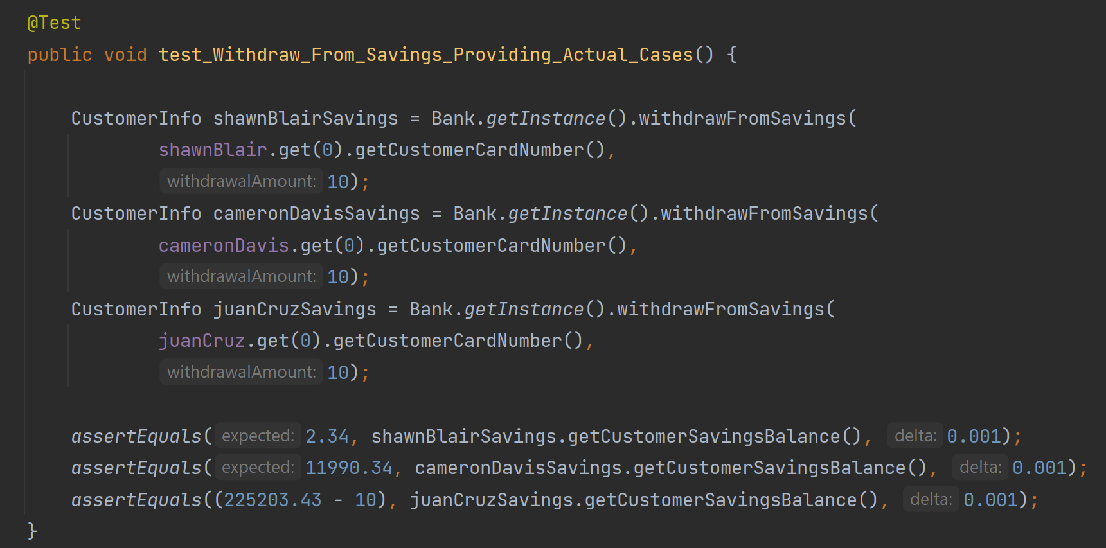
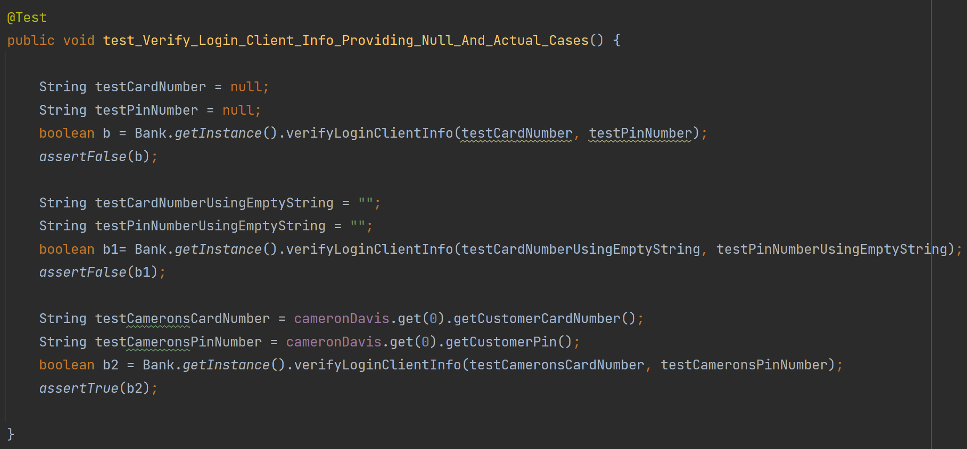
Test Code
Majority of business methods returned void – had to set a return type specifically for testing purposes
Use of String type allowed us to minimize type mismatches from customer inputs
Tested null, empty, and String values

Slide 13
Mistakes made / lessons learned
The conceptualized approach to coding an abstract idea is immensely important
Starting with user stories, deciding on an MVP, then working backwards from there to create a structure that follows Open-Closed, Encapsulation
Spend more time scrutinizing what questions and concepts are important and how we can feasibly implement them with the experience & tools that we have
We started with a complex UML / concept, which became greatly simplified to produce a working MVP and lost sight of some design best practices (DRY, Open-Closed, Single Responsibility)
More experience would improve design practice discipline

Slide 14
Features we'd add given more time
Complete Database integration – account states saved between client interactions
Decouple so much of our business logic from one class (Bank.java)
Create concrete implementations of ATM Transactions?
Refactor project structure to better accommodate an Open Closed framework
Enable our code to easily adopt a GUI-based UI

Slide 15

ATM Project DEMO

Slide 16

Thank You
Team CamShaJuan

